Slide 1
Electrical Energy and Current
Holt Chapter 17
“Electricity”
Reading this chapter is strongly recommended
A basic overview: http://www.howequipmentworks.com/electricity_basics/

Slide 2
A Brief History
Ancient Greeks
  Observed electric and magnetic phenomena as early as 700 BC
    Found that amber, when rubbed, became electrified and attracted pieces of straw or feathers
    Magnetic forces were discovered by observing magnetite attracting iron

Slide 3
A Quick Review
(that you shouldn’t need)
Two types of charges exist
  They are called positive and negative
Like charges repel and unlike charges attract one another
Nature’s basic carrier of positive charge is the proton
Nature’s basic carrier of negative charge is the electron
  Gaining or losing electrons is how an object becomes charged
Electric charge is always conserved (Charge is not created, only exchanged)
Charge is quantized
  Electrons have a charge of –e
  Protons have a charge of +e
  The SI unit of charge is the Coulomb (C)
    e = 1.6 x 10⁻¹⁹ C

Slide 4
Electric Potential
Holt Chapter 17 Section 1

Slide 5
Electrical Potential Energy
Electrical Potential Energy: Potential energy associated with a charge due to its position in an electric field
  This is dastardly similar to gravitational potential energy, which we discussed long ago…
Electrical Potential Energy (U_{electric} or PE_{electric}) is a part of mechanical energy and can be grouped with gravitational or elastic potential
Potential energy can be easily calculated in a uniform electric field using the equation:
Very Similar 

Slide 6
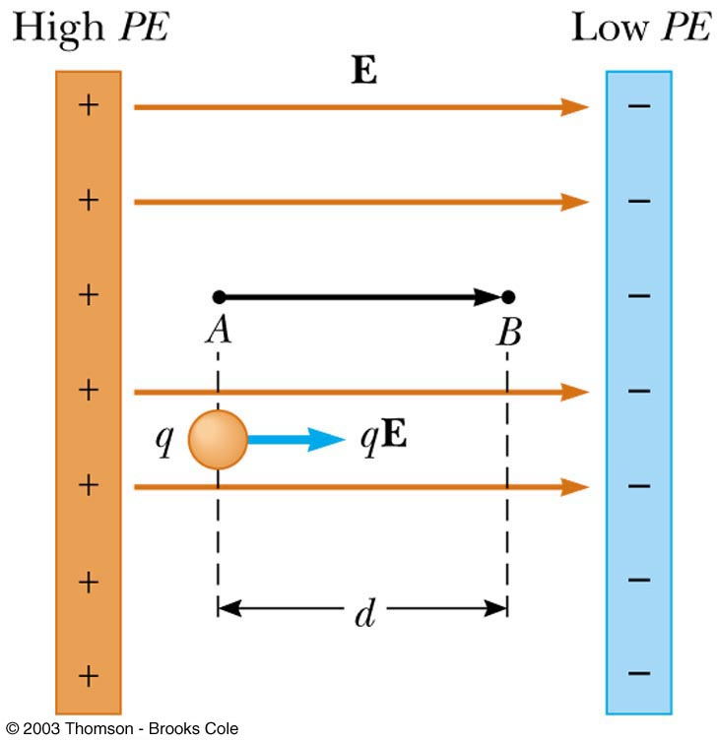
Work and Potential Energy
There is a uniform field between the two plates
As the charge moves from A to B, work is done in it
Remember the Work-Energy Theorem
  W = E_{k} = -U
Blue bordered slides are optional…

Slide 7
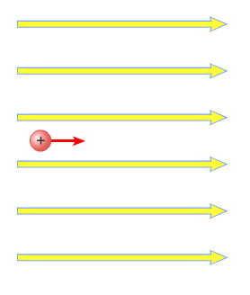
Electrical Potential Energy
Potential energy can be easily calculated in a uniform electric field using the equation:
E
Very Similar 
A
B
A positive charge moves from point A to B in a uniform electric field, and the potential energy changes as a result
d
Blue bordered slides are optional…

Slide 8
A Quick Proof of Electrical Potential Energy and Analogy to U_{g}
The Equation for Electrical Potential Energy has some surprising roots:
  The Work-Energy Theorem
  The Definition of Work
  Redefine Work with F=ma
  Sub -U_{electric} for work
  The basic units are analogous 
  Gravity & E-fields are analogous 
Blue bordered slides are optional…

Slide 9
Electric Potential
Potential energy is a useful concept, but it is more convenient to describe it without charge
Electric Potential: The potential energy of a particle in a field divided by the charge of the particle
  This definition means that electric potential is like potential energy, but independent of charge
  Electric potential is Describe by the unit: Volts (V)
    Volts are derived units that can be made many ways

Slide 10
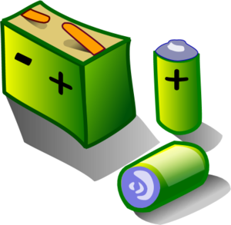
Potential Difference
Potential: When the term potential is used it is describing the potential energy of electricity that can flow continuously, as in a circuit
  This is different from Electrical potential energy which was only for single point charges (that usually don’t move)
Potential difference is useful to describe the energy to get flowing charge from one point (often a battery terminal) to the other

Slide 11
Table of Charge-based Units
Quantity | Unit | Unit symbol | Typical variable | Derived combination
Charge | Coulomb | C | Q or q | *Basic unit
Electrical potential energy | Joule | J | U_{e} | Nm
Electrical potential | Volt | V | V | J/C or Nm/C
Electric constant | (compound) | Nm²/C² | k_{c} | *irrelevant

Slide 12
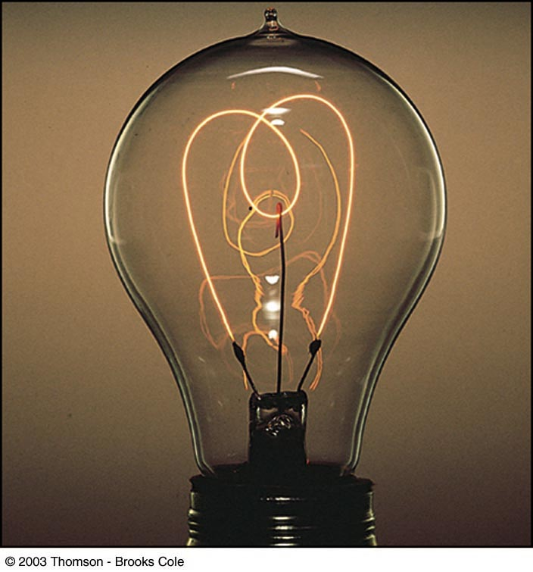
Current and Resistance
Holt Chapter 17 Section 3

Slide 13
Current and Charge Movement
Conductors
Insulators
Conductors are materials in which the electric charges move freely
  Copper, aluminum and silver are good conductors
  In terms of circuits, we will generally be using copper
  When a conductor is charged in a small region, the charge readily distributes itself over the entire surface of the material
Insulators are materials in which the electric charges cannot move freely
  Glass, wood and rubber are all good insulators
  Insulators can be charged, but that charge cannot distribute within the insulator

Slide 14
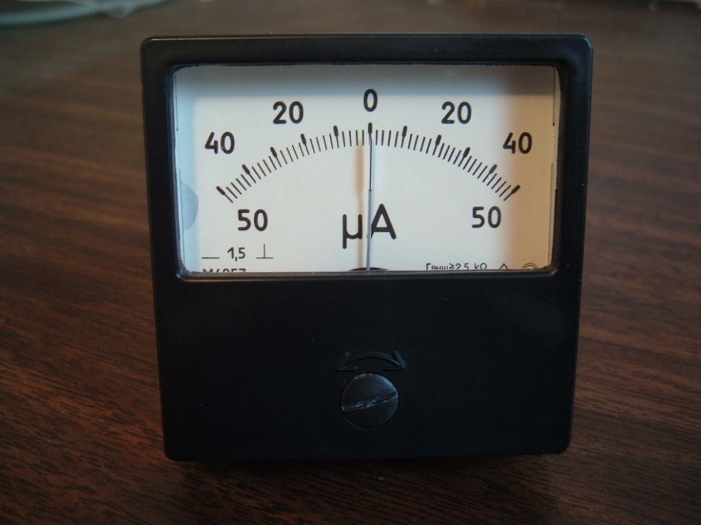
Electric Current
Whenever electric charges of like signs move, an electric current is said to exist
Current: rate at which the charge flows through a surface:
  The example to the left is charge moving though a length of wire for clarity
  The SI unit of current is Ampere (A)
    1 A = 1 C/s
+
+
+
+
+
+
+
Length of wire

Slide 15
Problems in Currents
The amount of charge that passes through the filament of a certain light bulb in 2.00s is 1.67C.
A) Determine the current in the light bulb.
B) How many electrons passed through the filament per second?

Slide 16
Ex. 2
A 100.0 W light bulb draws 0.83A of current.
How much charge passes a given cross-sectional area of the filament in 1 hour?
How many electrons pass a given cross-sectional area of the filament in 1 hour?

Slide 17
Ex. 3
1.5 x 10⁷ electrons pass through a given cross section of a wire every 1.0s.
  A) Find the current in the wire.
  B) How much charge (in C) passes through the wire per minute?

Slide 18
Analogy to Flow of Water
Electric Charge = Water
  Coulomb = Gallons of Water
Electric Current = Rate of Water Flow
  Ampere = Gallons of Water per second
Potential Difference = River height difference
Battery = Water pump

Slide 19
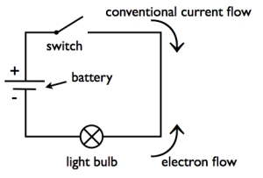
Electric Current
The direction of current flow is the direction positive charge (+) would flow
  This is known as conventional current flow
    This convention was made before we knew about electrons
    In a common conductor, such as copper, the current is due to the motion of the negatively charged electrons

Slide 20
Drift Velocity
Drift Velocity is the velocity at which electrons move opposite the electric field (E).
Counterintuitively, drift velocity is very small.
  Example: 2.46 x 10⁻⁴ m/s in Cu wire
So how does the electric light turn on so quickly??? Hmmmmm…
  A wire is already full of electrons that are there because the wire is made of atoms
  The first flowing electrons incite a wave of movement down the wire and force other electrons to move
  The wave travels at the speed of light

Slide 21
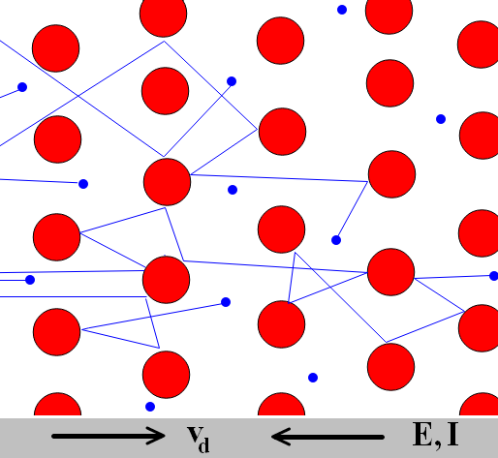
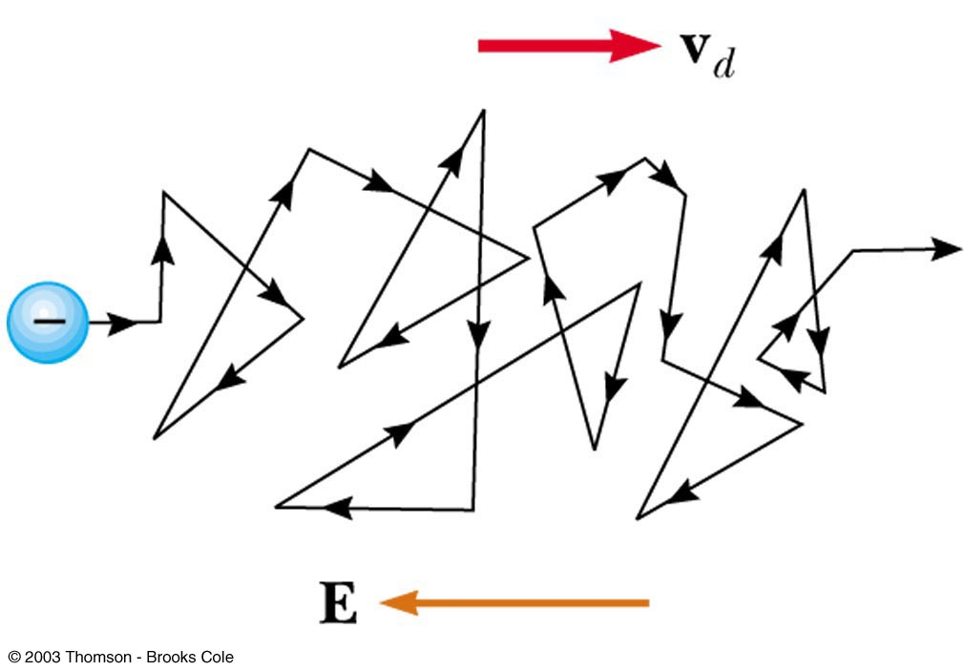
Charge Carrier Motion in a Conductor
The zig-zag black line represents the motion of charge carrier in a conductor
  The net drift speed is small
The sharp changes in direction are due to collisions
The net motion of electrons is opposite the direction of the electric field

Slide 22
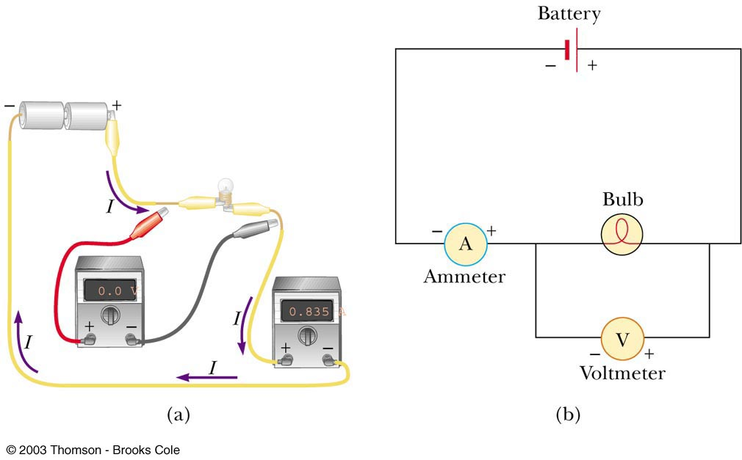
Meters in a Circuit Ammeter
An ammeter is used to measure current
  In line with the bulb, all the charge passing through the bulb also must pass through the meter

Slide 23
Meters in a Circuit Voltmeter
A voltmeter is used to measure voltage (potential difference)
  Connects to the two ends of the bulb

Slide 24
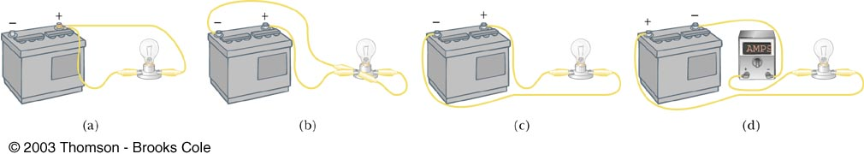
Look at the four “circuits” shown below and select those that will light the bulb.
QUICK QUIZ

Slide 25
Table of Charge-based Units
Quantity | Unit name | Unit symbol | Typical variable | Derived combination
Charge | Coulomb | C | Q or q | *Basic unit
Electric field | Spoken symbol → | N/C | E | (Kg m)/(s² C)
Electrical potential energy | Joule | J | U_{e} | Nm
Electrical potential | Volt | V | V | J/C or Nm/C
Potential difference | Volt | V | ΔV | J/C or Nm/C
Electric constant | (compound) | Nm²/C² | k_{c} | *irrelevant
Current | Ampere | Amp | I | C/s

Slide 26
Resistance
Should have been a separate section…

Slide 27
Resistance
In a conductor, the voltage applied across the ends of the conductor is proportional to the current through the conductor
The constant of proportionality is the resistance of the conductor

Slide 28
Resistance
Units of resistance are ohms (Ω)
  1 Ω = 1 V / A
Resistance in a circuit arises due to collisions between the electrons carrying the current with the fixed atoms inside the conductor (analogous to water colliding with rocks in a river)

Slide 29
Analogy to Flow of Water
Electric Charge = Water
  Coulomb = Gallons of Water
Electric Current = Rate of Water Flow
  Ampere = Gallons of Water per second
Potential Difference = River height difference
Battery = Water pump
Size of Wire = Size of River
Resistance = Rocks in the River

Slide 30
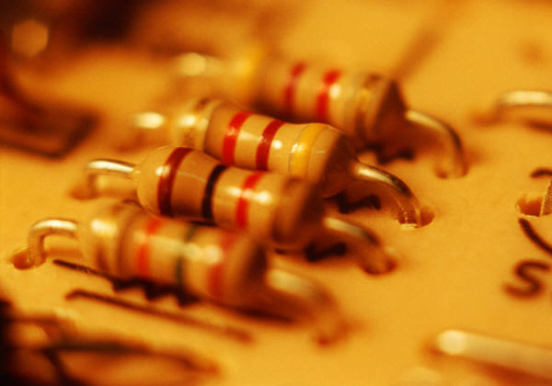
Ohm’s Law
In general, resistance remains constant over a wide range of applied voltages or currents
This statement has become known as Ohm’s Law

Slide 31
Ohm’s Law
The resistance is constant over a wide range of voltages
The relationship between current and voltage is linear

Slide 32
Ex. 4
The plate on a steam iron states that the current in the iron is 6.4A when the iron is connected across a potential difference of 120V. What is the resistance of the steam iron?

Slide 33
Factors affecting resistance
Length of a resistor – R increases with length (directly prop.)
Cross-sectional area – R increases with smaller cross-sectional area (inv. prop.)
Material – different metals have different resistances
Temperature – R increases with temperature (dir. prop.)

Slide 34
Resistivity
The resistance of an ohmic conductor is proportional to its length, L, and inversely proportional to its cross-sectional area, A
  ρ is the constant of proportionality and is called the resistivity of the material
  See table 17.1

Slide 35
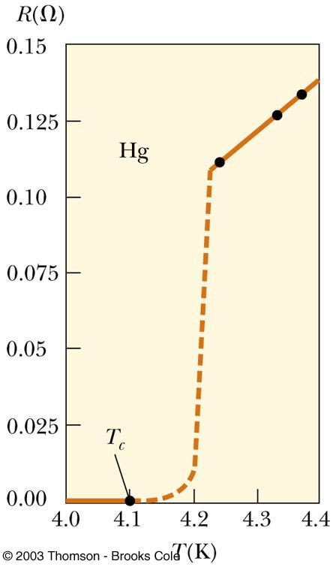
Superconductors
A class of materials and compounds whose resistances fall to virtually zero below a certain temperature, T_{C}
  T_{C} is called the critical temperature
  https://youtu.be/zPqEEZa2Gis
Once a current is set up in a superconductor, it persists without any applied voltage
  Since R = 0

Slide 36
Superconductors
Once a current is set up in a superconductor, it persists without any applied voltage
  Since R = 0

Slide 37
Table of Charge-based Units
Quantity | Unit name | Unit symbol | Typical variable | Derived combination
Charge | Coulomb | C | Q or q | *Basic unit
Electric field | Spoken symbol → | N/C | E | (Kg m)/(s² C)
Electrical potential energy | Joule | J | U_{e} | Nm
Electrical potential | Volt | V | V | J/C or Nm/C
Potential difference | Volt | V | ΔV | J/C or Nm/C
Electric constant | (compound) | Nm²/C² | k_{c} | *irrelevant
Current | Ampere | Amp | I | C/s
Resistance | Ohms | Ω | R | V/A or Js/C²
Resistivity | (compound) | Ωm | ρ

Slide 38
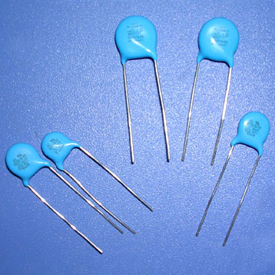
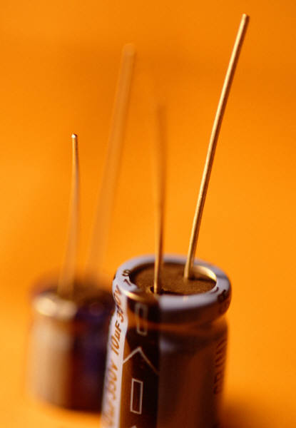
Capacitance
Holt Chapter 17 Section 2

Slide 39



What is a capacitor?
A capacitor is an electrical device that stores charge.
Once a capacitor is full of charge, the current stops flowing until some of the charge is emptied out of the capacitor.
Where are capacitors used?
  TVs, computers, camera flashes

Slide 40
Mathematically, what is capacitance?
Capacitance (C) is a measure of how much charge (Q) can be stored per unit voltage or potential difference (V)
  Capacitance is measured in farads (F)
  Practically, most capacitors measure in the microfarad (10⁻⁶F)or picofarad (10⁻¹²F).

Slide 41
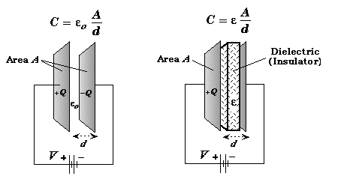
Structure of a Capacitor
Most capacitors are composed of two parallel plates (called a parallel plate capacitor).

Slide 42
Water Analogies
Voltage = Water Pump
Current = Flow of River
Resistance = Rocks in the river
Capicitance = Bucket that fills with water; stores the water until some of it is dumped out and then it fills up again

Slide 43
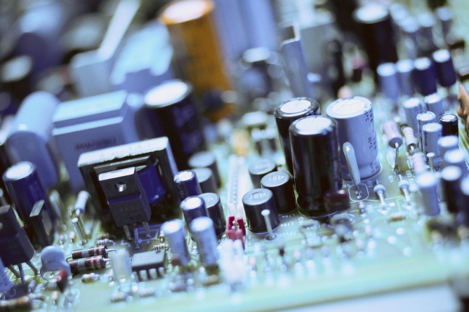
Current in a capacitor
Depends on four things:
  Based on the Circuit
    Resistance in the circuit
    Voltage applied to the capacitor
  Based on the Capacitor
    Amount of charge already stored in the capacitor
    The Capacitance (C - measured in farads) of the capacitor

Slide 44
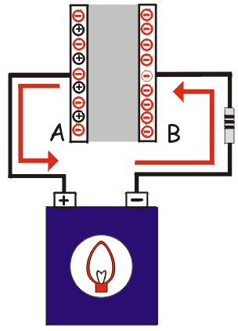
Charging a capacitor
Connect the capacitor to a source of voltage (like a battery)
As the capacitor charges, the voltage increases until its voltage is equal to the battery’s voltage
When the two are equal, current stops flowing because there is no potential difference remaining

Slide 45

Discharging a capacitor
A capacitor can be discharged by connecting it to any closed circuit that allows current to flow.
The less resistance present in the circuit, the faster the capacitor will be discharged
Current

Slide 46
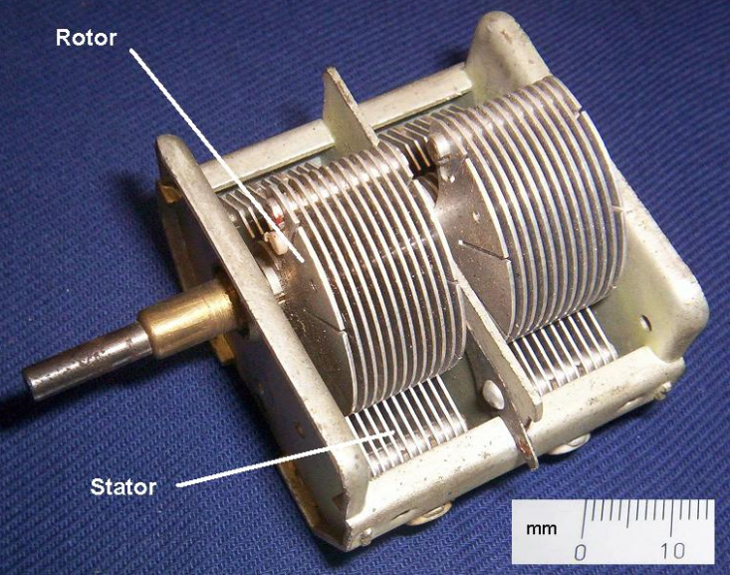
Mathematically …
Capacitance depends on:
  Type of dielectric material
    (measured by ε – permittivity of the medium)
  Overlapping area of plates
  Distance between plates
Capacitor Plate 2
Capacitor Plate 1
  (In a vacuum, ε_{o} = 8.85x 10⁻¹² C²/Nm²)

Slide 47
Energy in Capacitors
Because it takes work to move the charges throughout the circuit, by storing the charges, there is potential electrical energy
This potential energy is measured by the following formula:

Slide 48
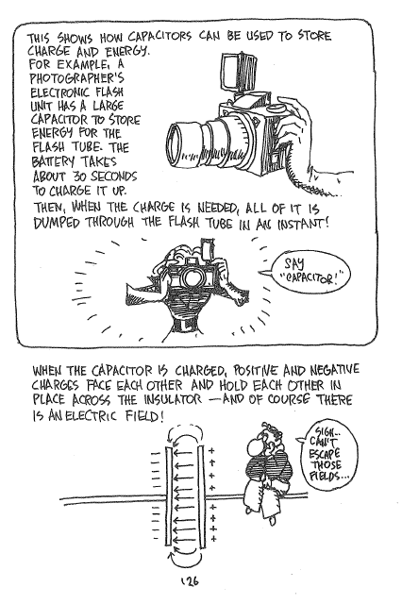
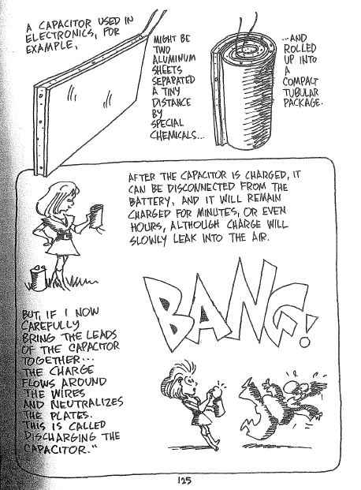
Capacitors and Charge Storage
Capacitors can hold a charge after they have been hooked up to a power supply
They can hold this charge for up to a few hours before it slowly leaks out into the air
Capacitors are what we can use to store and discharge energy very quickly
  Cameras are a prime example

Slide 49
Table of Charge-based Units
Quantity | Unit name | Unit symbol | Typical variable | Derived combination
Charge | Coulomb | C | Q or q | *Basic unit
Electric field | Spoken symbol → | N/C | E | (Kg m)/(s² C)
Electrical potential energy | Joule | J | U_{e} | Nm
Electrical potential | Volt | V | V | J/C or Nm/C
Potential difference | Volt | V | ΔV | J/C or Nm/C
Electric constant | (compound) | Nm²/C² | k_{c} | *irrelevant
Current | Ampere | Amp | I | C/s
Resistance | Ohms | Ω | R | V/A or Js/C²
Resistivity | (compound) | Ωm | ρ
Capacitance | Farad | F | C | C/V
Electrical permittivity | Spoken symbol → | F/m | ε | C/Vm

Slide 50
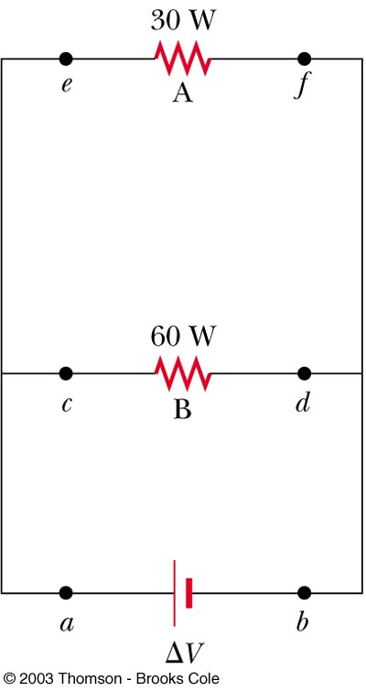
For the two resistors shown here, rank the currents at points a through f, from largest to smallest.
QUICK QUIZ 17.6

Slide 51
I_{a} = I_{b} > I_{c} = I_{d} > I_{e} = I_{f} . Charges constituting the current I_{a} leave the positive terminal of the battery and then split to flow through the two bulbs; thus, I_{a} = I_{c} + I_{e}. Because the potential difference ΔV is the same across the two bulbs and because the power delivered to a device is P = I(ΔV), the 60–W bulb with the higher power rating must carry the greater current. Because charge does not accumulate in the bulbs, all the charge flowing into a bulb from the left has to flow out on the right; consequently I_{c} = I_{d} and I_{e} = I_{f}. The two currents leaving the bulbs recombine to form the current back into the battery, I_{f} + I_{d} = I_{b}.
QUICK QUIZ 17.6 ANSWER

Slide 52
Two resistors, A and B, are connected across the same potential difference. The resistance of A is twice that of B. (a) Which resistor dissipates more power? (b) Which carries the greater current?
QUICK QUIZ 17.7

Slide 53
B, B. Because the voltage across each resistor is the same, and the rate of energy delivered to a resistor is P = (ΔV)²/R, the resistor with the lower resistance exhibits the higher rate of energy transfer. In this case, the resistance of B is smaller than that for A and thus B dissipates more power. Furthermore, because P = I(ΔV), the current carried by B is larger than that of A.
QUICK QUIZ 17.7 ANSWER

Slide 54
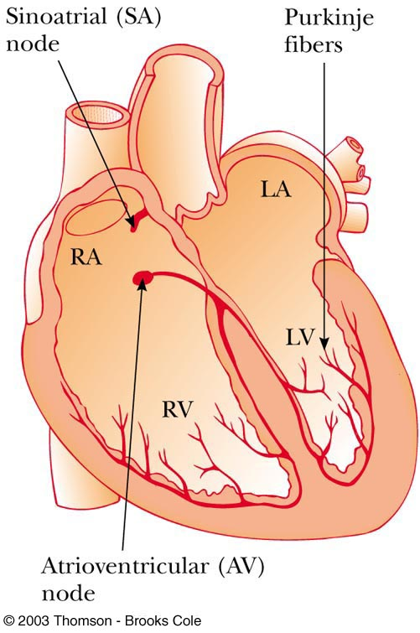
Electrical Activity in the Heart
Every action involving the body’s muscles is initiated by electrical activity
Voltage pulses cause the heart to beat
These voltage pulses are large enough to be detected by equipment attached to the skin

Slide 55
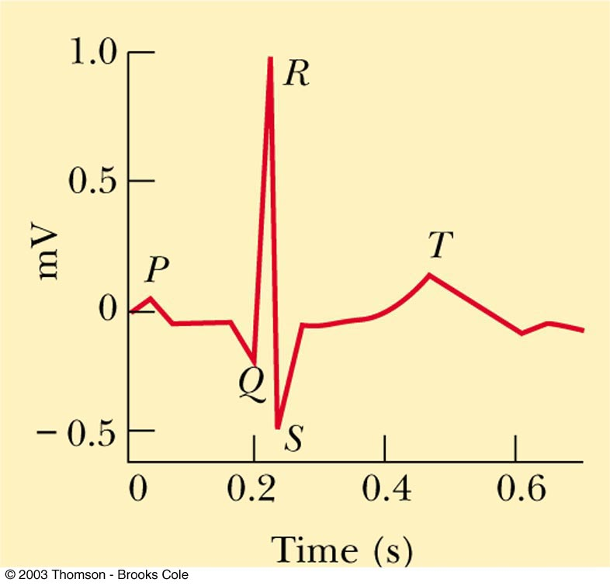
Electrocardiogram (EKG)
A normal EKG
P occurs just before the atria begin to contract
The QRS pulse occurs in the ventricles just before they contract
The T pulse occurs when the cells in the ventricles begin to recover

Slide 56
Electrical Energy and Power
The rate at which the energy is lost is the power
From Ohm’s Law, alternate forms of power are

Slide 57
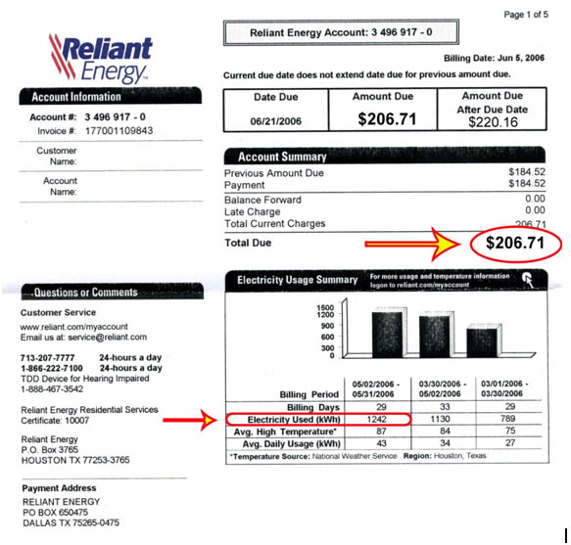
Electrical Energy and Power
The SI unit of power is Watt (W)
  Remember power refers to the rate of energy use
  I must be in Amperes, R in ohms and V in Volts
The unit of energy used by electric companies is the kilowatt-hour
  This is defined in terms of the unit of power and the amount of time it is supplied
  1 kWh = 3.60 x 10⁶ J

Slide 58
Table of Charge-based Units
Quantity | Unit name | Unit symbol | Typical variable | Derived combination
Charge | Coulomb | C | Q or q | *Basic unit
Electric field | Spoken symbol → | N/C | E | (Kg m)/(s² C)
Electrical potential energy | Joule | J | U_{e} | Nm
Electrical potential | Volt | V | V | J/C or Nm/C
Potential difference | Volt | V | ΔV | J/C or Nm/C
Electric constant | (compound) | Nm²/C² | k_{c} | *irrelevant
Current | Ampere | Amp | I | C/s
Resistance | Ohms | Ω | R | V/A or Js/C²
Resistivity | (compound) | Ωm | ρ | *irrelevant
Capacitance | Farad | F | C | C/V
Electrical permittivity | Spoken symbol → | F/m | ε | C/Vm
Power | Watts | W | P | J/s

Slide 59
Electric Power
Holt Chapter 17 Section 4

Slide 60
Table of Charge-based Units
Quantity | Unit name | Unit symbol | Typical variable | Derived combination
Charge | Coulomb | C | Q or q | *Basic unit
Electric field | Spoken symbol → | N/C | E | (Kg m)/(s² C)
Electrical potential energy | Joule | J | U_{e} | Nm
Electrical potential | Volt | V | V | J/C or Nm/C
Potential difference | Volt | V | ΔV | J/C or Nm/C
Electric constant | (compound) | Nm²/C² | k_{c} | *irrelevant
Current | Ampere | Amp | I | C/s
Resistance | Ohms | Ω | R | V/A or Js/C²
Resistivity | (compound) | Ωm | ρ | *irrelevant
Capacitance | Farad | F | C | C/V
Electrical permittivity | Spoken symbol → | F/m | ε | C/Vm
Power | Watts | W | P | J/s

